Slide 1
COMP 4332 / RMBI 4310 Big Data Mining (Spring 2019)
Tutorial 1: Multi Layer Perceptron
TA: Xin Liu (xliucr@connect.ust.hk)

Slide 2
Single Layer Perceptron
Advantages
Simple and computationally efficient
Guaranteed to learn a linearly separable problem (convergence, global optimum)
Limitations
Only linear separations
Only converges for linearly separable data
Not really “efficient with many features”
1
T
2
7
3
4
5
6

Slide 3
Multi Layer Perceptron
Define an error function (e.g., sum of squares) that is a differentiable function of the output, i.e. this error function is also a differentiable function of the weights.
We can then evaluate the derivatives of the error with respect to the weights, and use these derivatives to find weight values that minimize this error function, using gradient descent (or other optimization methods).
Backpropagation
activation
Output
Hidden
Input

Slide 4
Let’s get started

Slide 5
Python Environment
Anaconda is a very stable distribution of Python (amongst other things). Installing it is easy:
https://www.anaconda.com/distribution/#download-section

Slide 6
Python Environment
One annoying install step - adding where you installed it to the front of your PATH environment variable.
$ export PATH=/path/to/anaconda/bin:PATH

Slide 7
Virtual Environment
Every time you start a new project, make a new virtual environment which has only its dependencies in.
$ conda create -n COMP4332 python=3.6

Slide 8
Virtual Environment
Before you work on your project, run this command. This prepends the location of this particular copy of Python to your PATH.
$ source activate COMP4332

Slide 9
Virtual Environment
When you’re done, or you want to work on a different project, run:
$ source deactivate COMP4332

Slide 10
Installing Packages
Choose a virtual environment:
$ source activate COMP4332
And then install necessary packages via conda or pip:
$ conda install numpy
or
$ pip install numpy

Slide 11
Installing Packages
Because we use Keras in the course this semester, we need to install the Keras deep learning framework and use tensorflow as the backend:
Tensorflow:
https://www.tensorflow.org/install/pip
Keras:
https://keras.io/#installation

Slide 12
Installing Packages
And install all other packages:
$ pip install nltk pandas scikit-learn
Besides, you also need to download some NLTK data:
$ python
>>> import nltk
>>> nltk.download (‘punkt’)
>>> nltk.download(‘stopwords’)
>>> exit()

Slide 13
What You Need to Do
We have provided skeleton part of the Multi Layer Perceptron.
You just need to finish the random projection part and MLP part.

Slide 14
Random Projection
There are multiple ways to represent documents. One way is to use bag-of-words and one-hot vectors. However, as the vocabulary size maybe very large and the documents vary in length, it is not easy to feed one-hot vectors to a perceptron. Hence, we will use Gaussian Random Projection to reduce the dimensionality of document vectors.

Slide 15
Random Projection Example
The sklearn package has provided a handful tool to perform the random projection, and this is the example given by the official document:
import numpy as np
from sklearn import random projection
X = np.random.rand(100 , 10000)
transformer = random_projection.GaussianRandomProjection()
X_new = transformer.fit_transform(X)
print(X_new.shape)
(100, 3947)

Slide 16
Adding Random Projection to the Skeleton
86 # Data random projection
87 rand_proj_transformer = random_projection.GaussianRandomProjection(n_components=2000)
88 # YOUR CODE HERE
89 train_data_matrix = rand_proj_transformer.fit_transform(train_data_matrix)
90 test_data_matrix = rand_proj_transformer.transform(test_data_matrix)

Slide 17
Keras Sequential Model
Keras is a deep learning framework and an API designed for human beings. Keras follows best practices for reducing cognitive load: it offers consistent & simple APIs, it minimizes the number of user actions required for common use cases, and it provides clear and actionable feedback upon user error.
Here we focus on the sequential model.

Slide 18
Multi Layer Perceptron in Keras
keras.models.Sequential is a linear stack of neural network layers. And we can add different types of neural network layers, such as keras.layers.Dense and keras.layers.Dropout.
We want to build a 4-layer MLP, including 1 input layer, 2 hidden layers, and 1 output layer.

Slide 19
Adding Multi Layer Perceptron to the Skeleton
117 # New model
118 model = Sequential()
120 # first hidder layer
121 model.add(Dense(hidden_size, activation='softmax', input_dim=input_size))
122 model.add(Dropout(dropout_rate))
124 # second hidden layer
125 # YOUR CODE HERE
126 model.add(Dense(hidden_size, activation='softmax’))
127 model.add(Dropout(dropout_rate))

Slide 20
Adding Multi Layer Perceptron to the Skeleton
129 # output layer
130 # YOUR CODE HERE
131 model.add(Dense(K, activation='softmax’))
133 # SGD optimizer with momentum
134 # YOUR CODE HERE
135 optimizer = SGD(lr=learning_rate, decay=1e-6, momentum=0.9, nesterov=True)

Slide 21
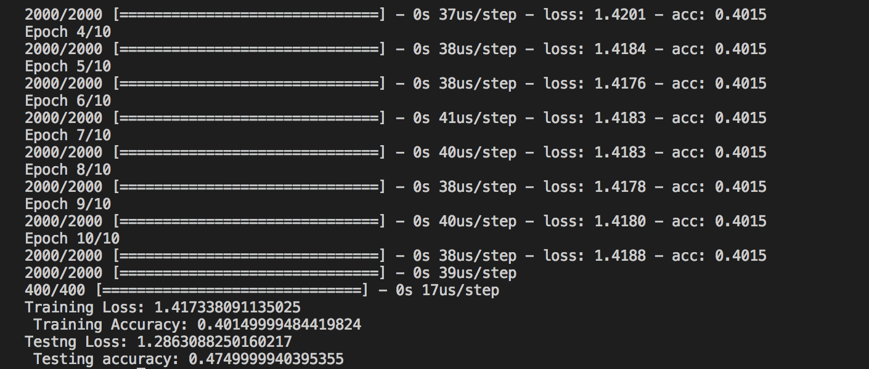
Test Your Code
$ python tut1_skeleton.py
Done!

Slide 22
Other Details in the Skeleton
NLTK is a leading platform for building Python programs to work with human language data.
NumPy is the fundamental package for scientific computing with Python.
pandas is an open source, BSD-licensed library providing high-performance, easy-to-use data structures and data analysis tools for the Python programming language.
Scikit-learn is a free software machine learning library for the Python programming language.

Slide 23
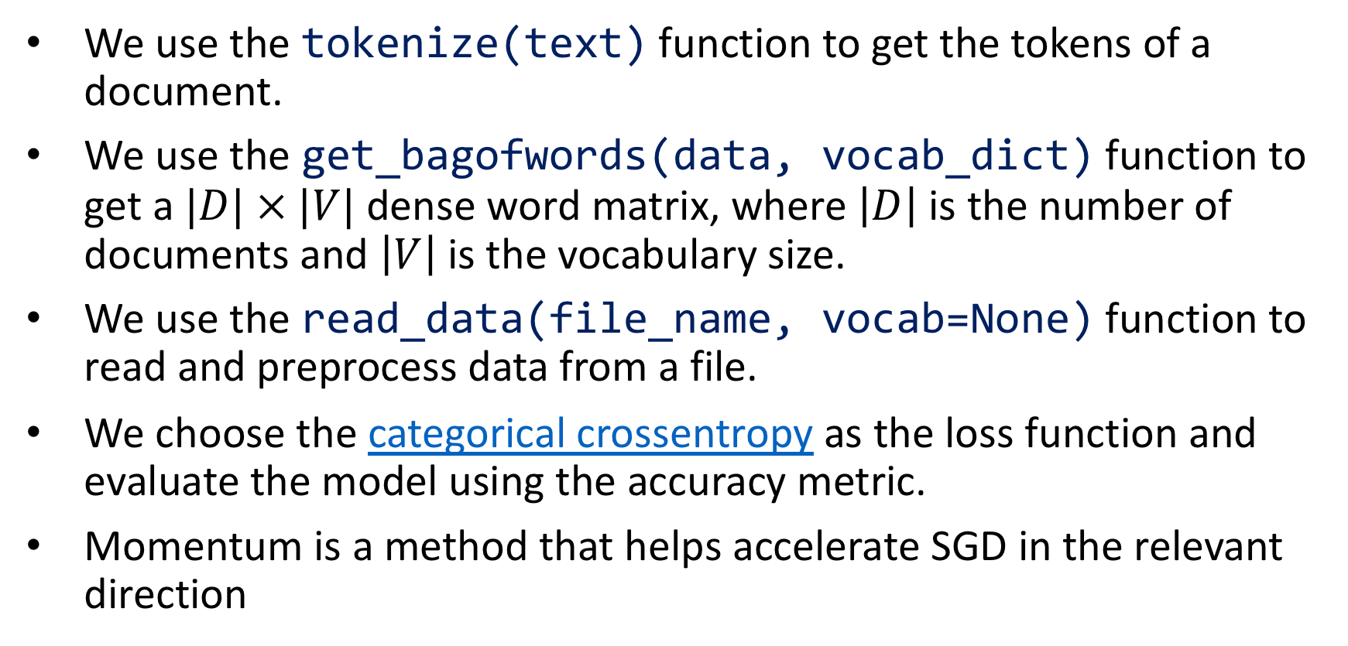
Other Details in the Skeleton
We use the tokenize(text) function to get the tokens of a document.
We use the get_bagofwords(data, vocab_dict) function to get a $|D| × |V|$ dense word matrix, where $\left|D\right|$ is the number of documents and $\left|V\right|$ is the vocabulary size.
We use the read_data(file_name, vocab=None) function to read and preprocess data from a file.
We choose the categorical crossentropy as the loss function and evaluate the model using the accuracy metric.
Momentum is a method that helps accelerate SGD in the relevant direction

Slide 24
Thank You

